Slide 1
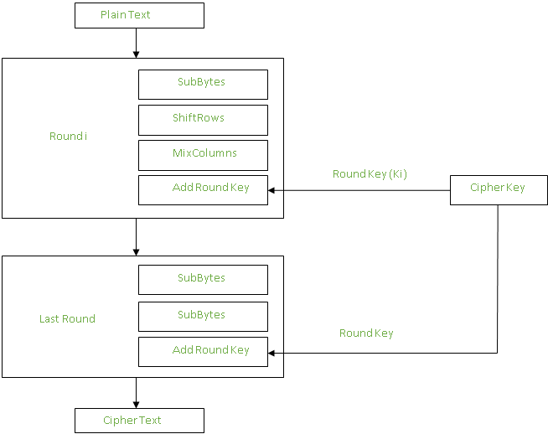



Each byte is substituted by another byte. It is performed using a lookup table (S-box)
The first row is not shifted
The second row is shifted once to the left.
The third row is shifted twice to the left.
The fourth row is shifted thrice to the left.
Each column is multiplied with a specific matrix
resultant output of the previous stage is XOR-ed with the corresponding round key.
Plaintext – 128 bits
Key:
128 bits key – 10 rounds
192 bits key – 12 rounds
256 bits key – 14 rounds
AES Encryption

Slide 2
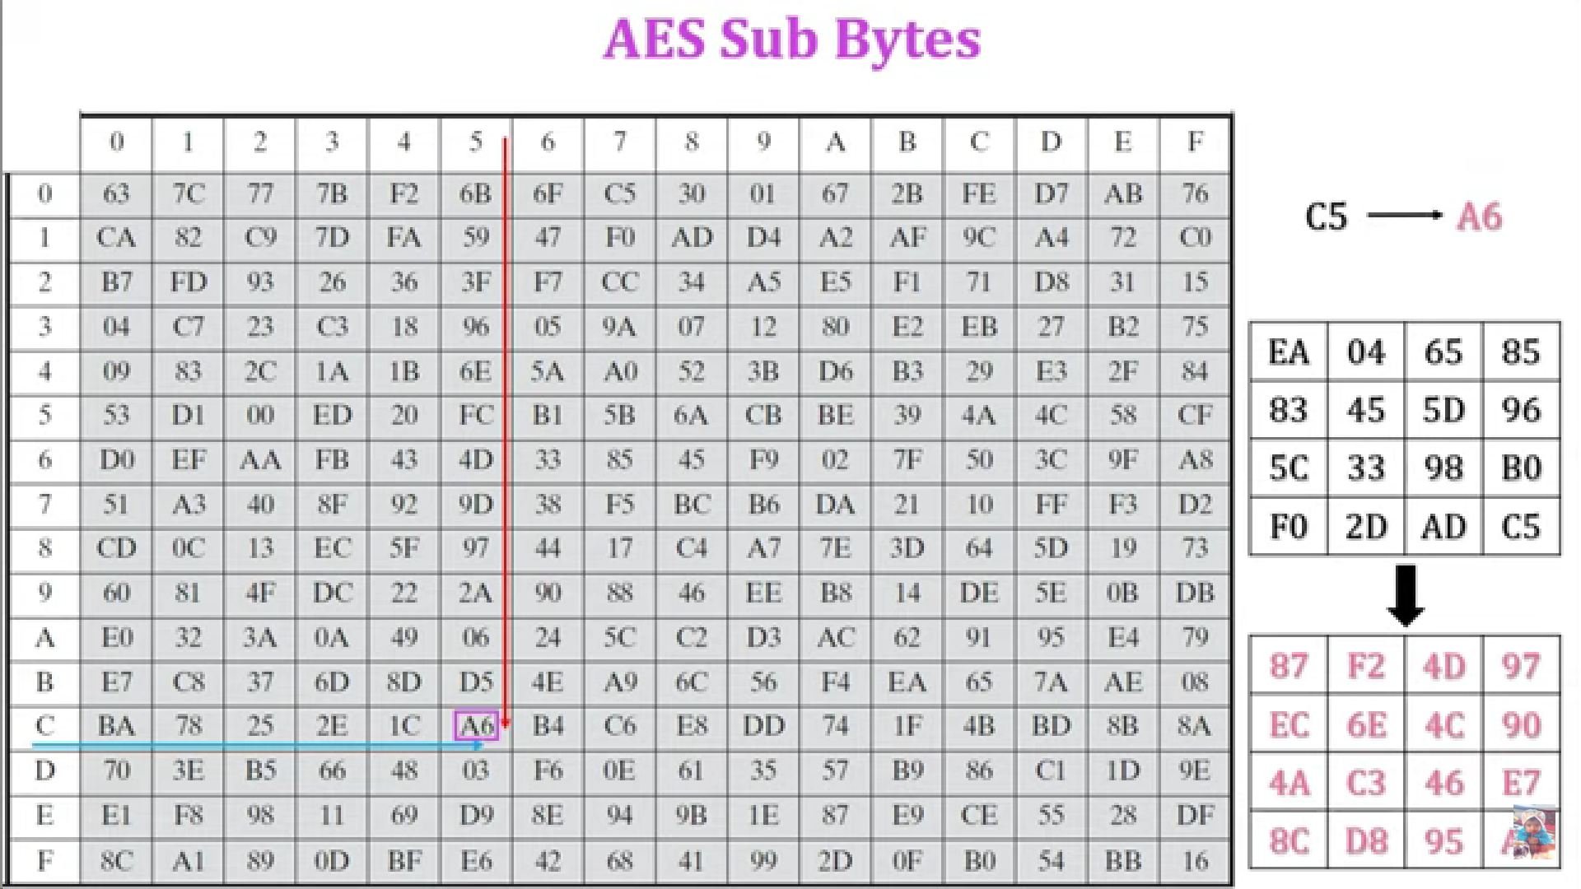
First digit represents row no.
Second digit represents column no.
Example:
A6

Slide 3
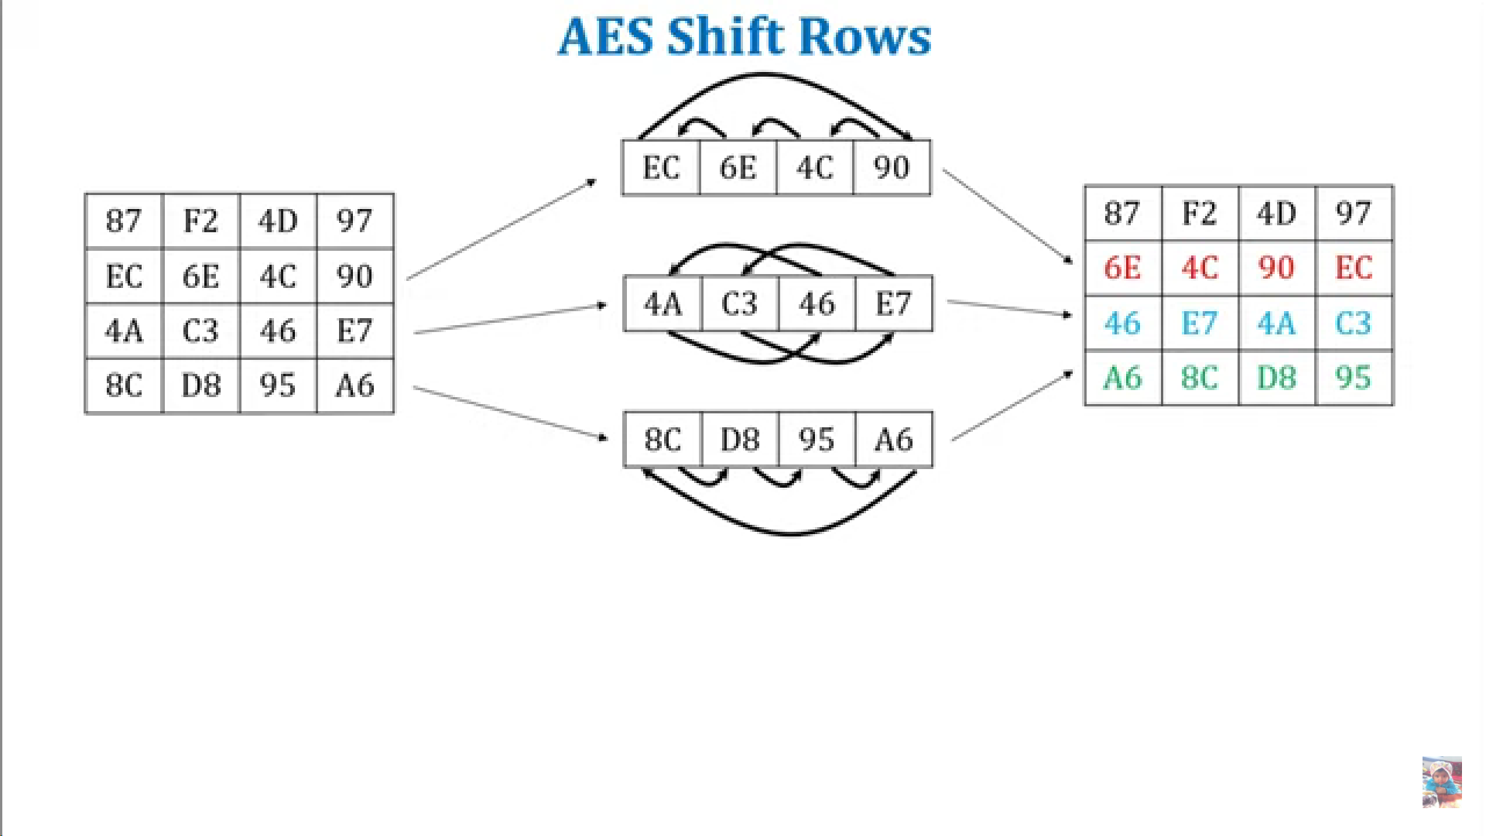
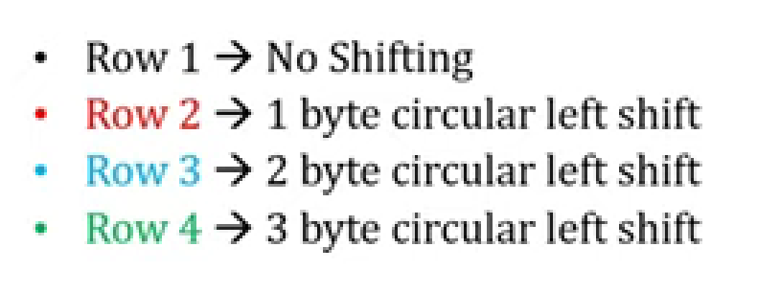

Slide 4
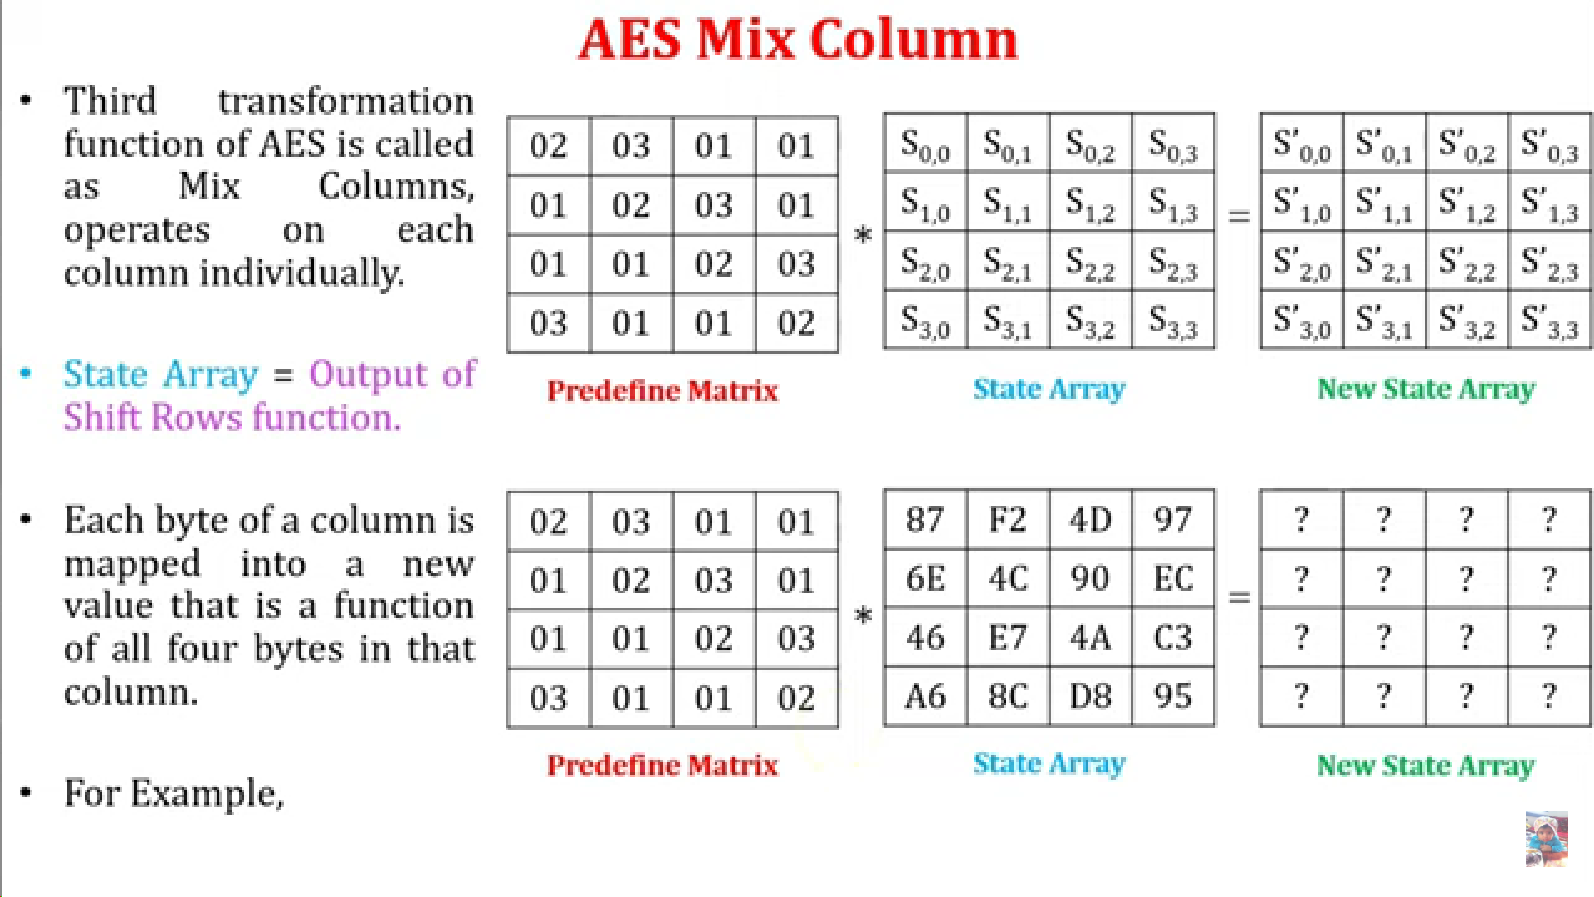




Learn this matrix

Slide 5
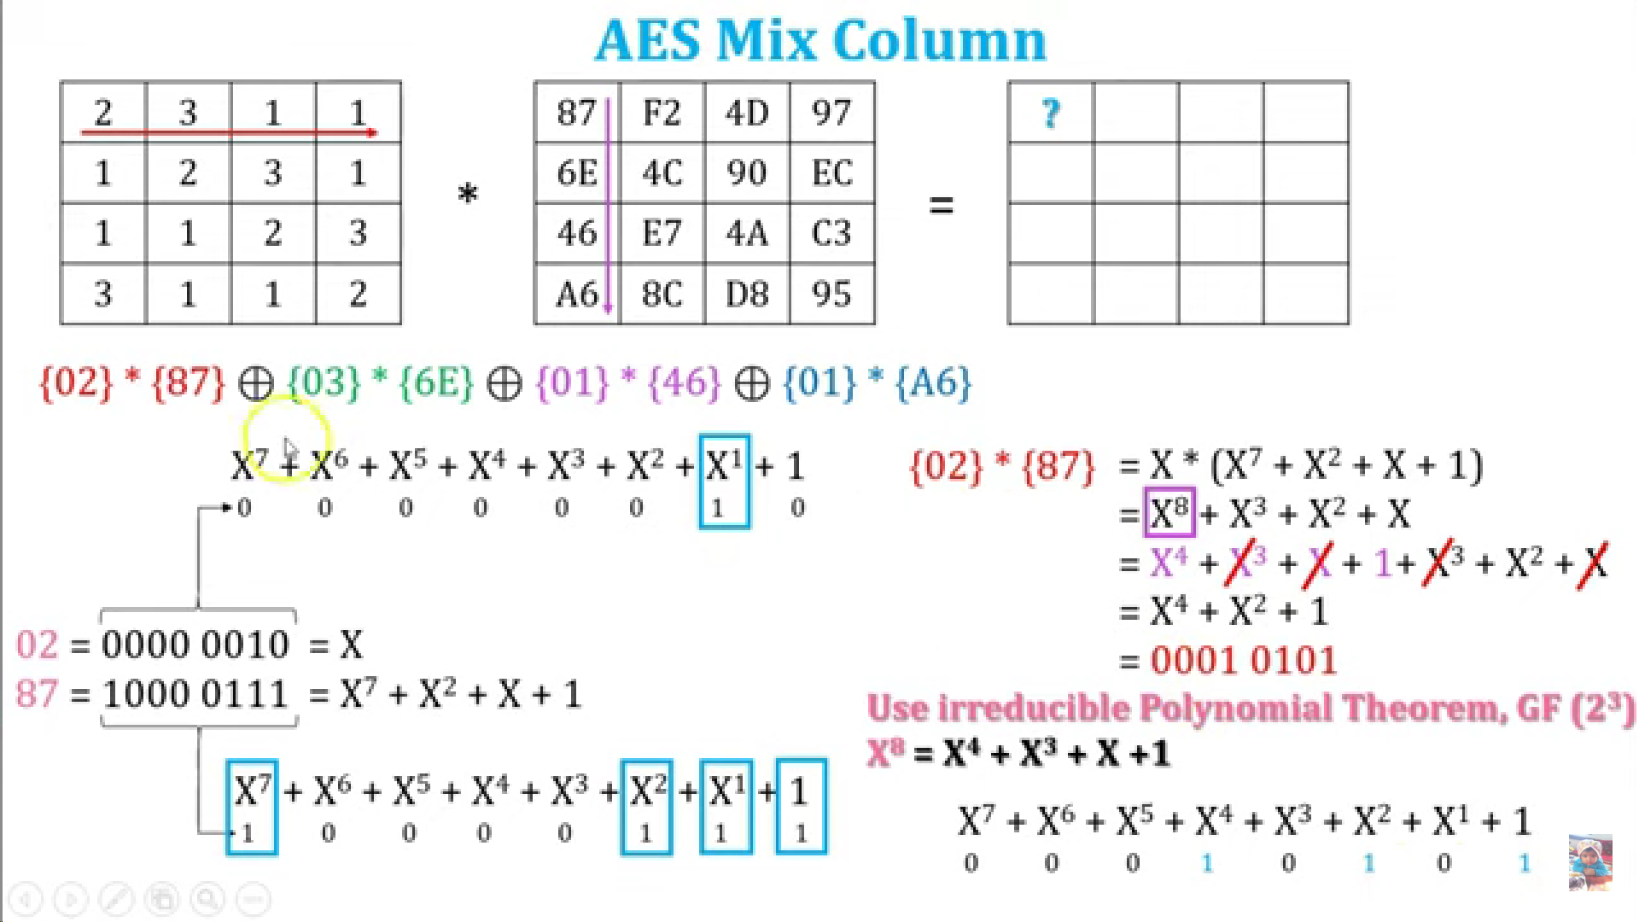

Slide 6
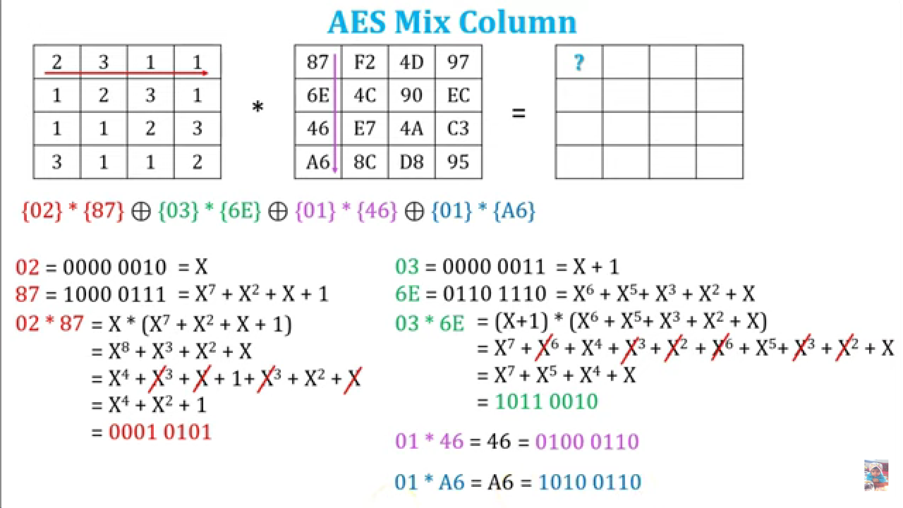

Slide 7
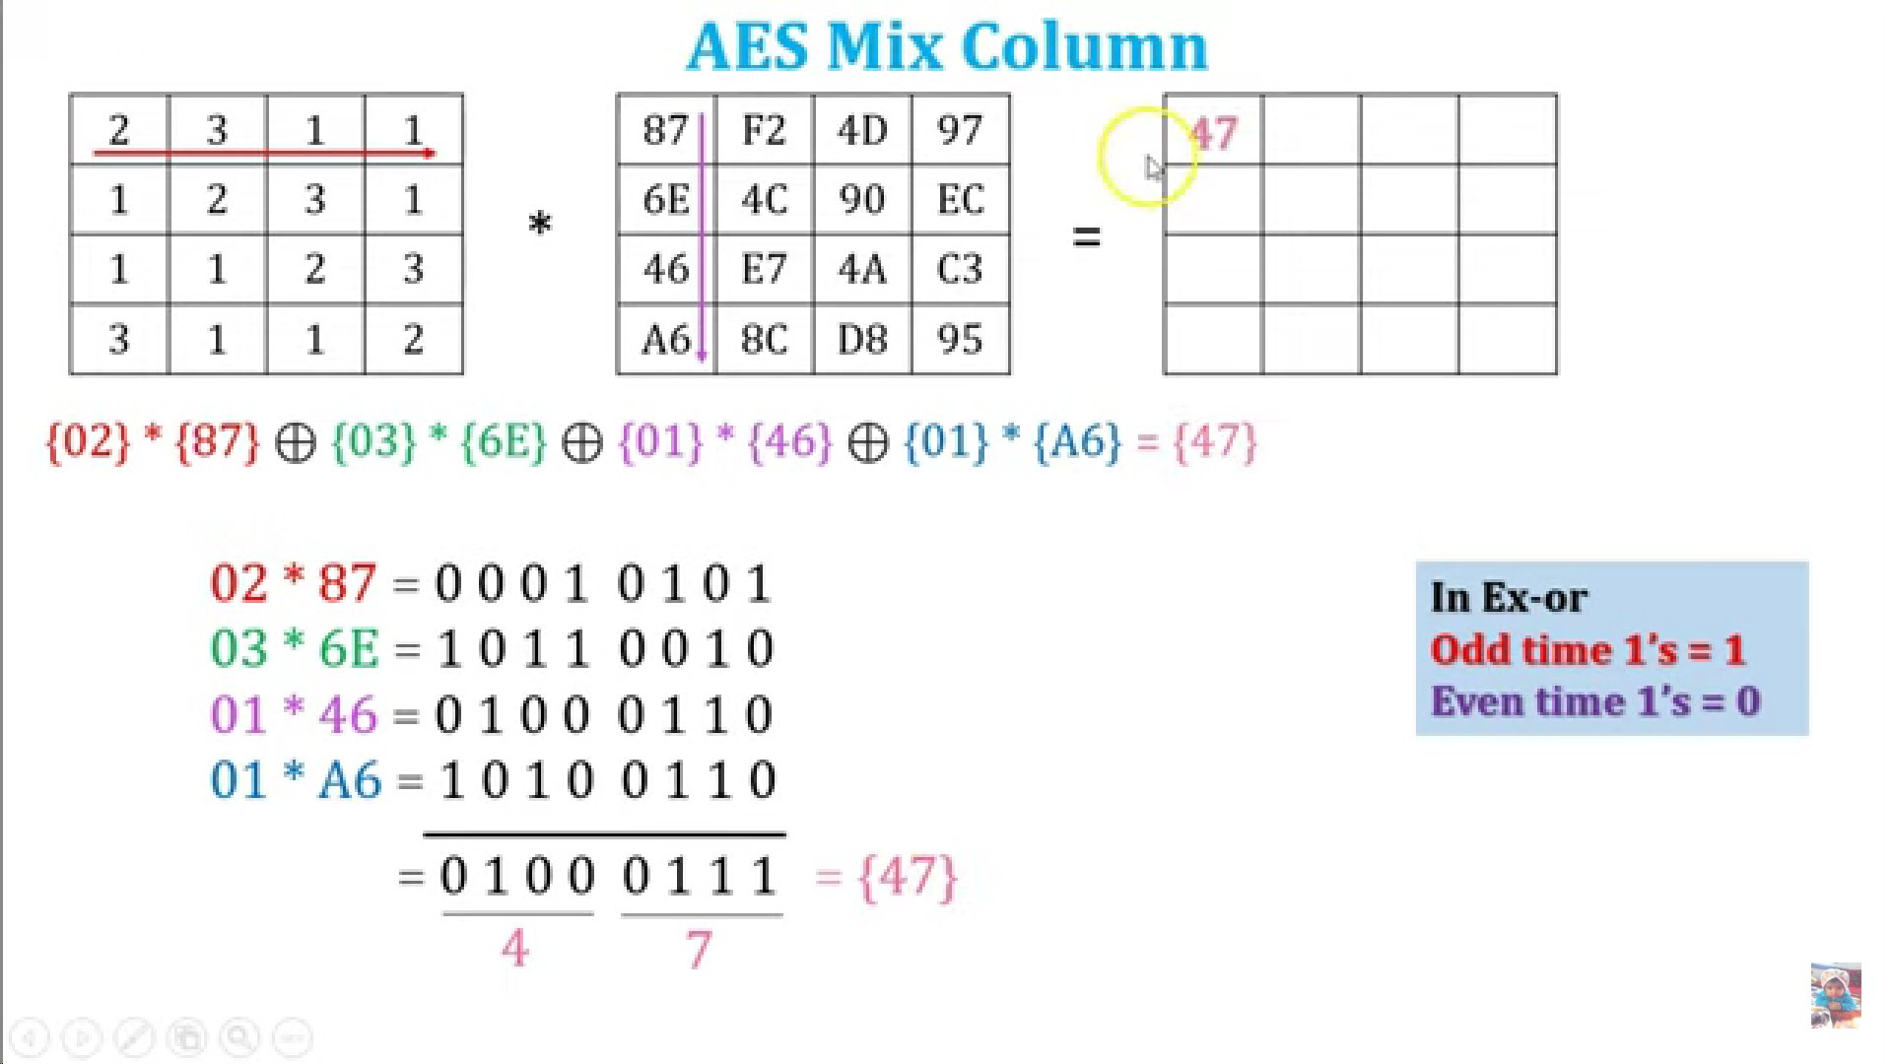

Slide 8
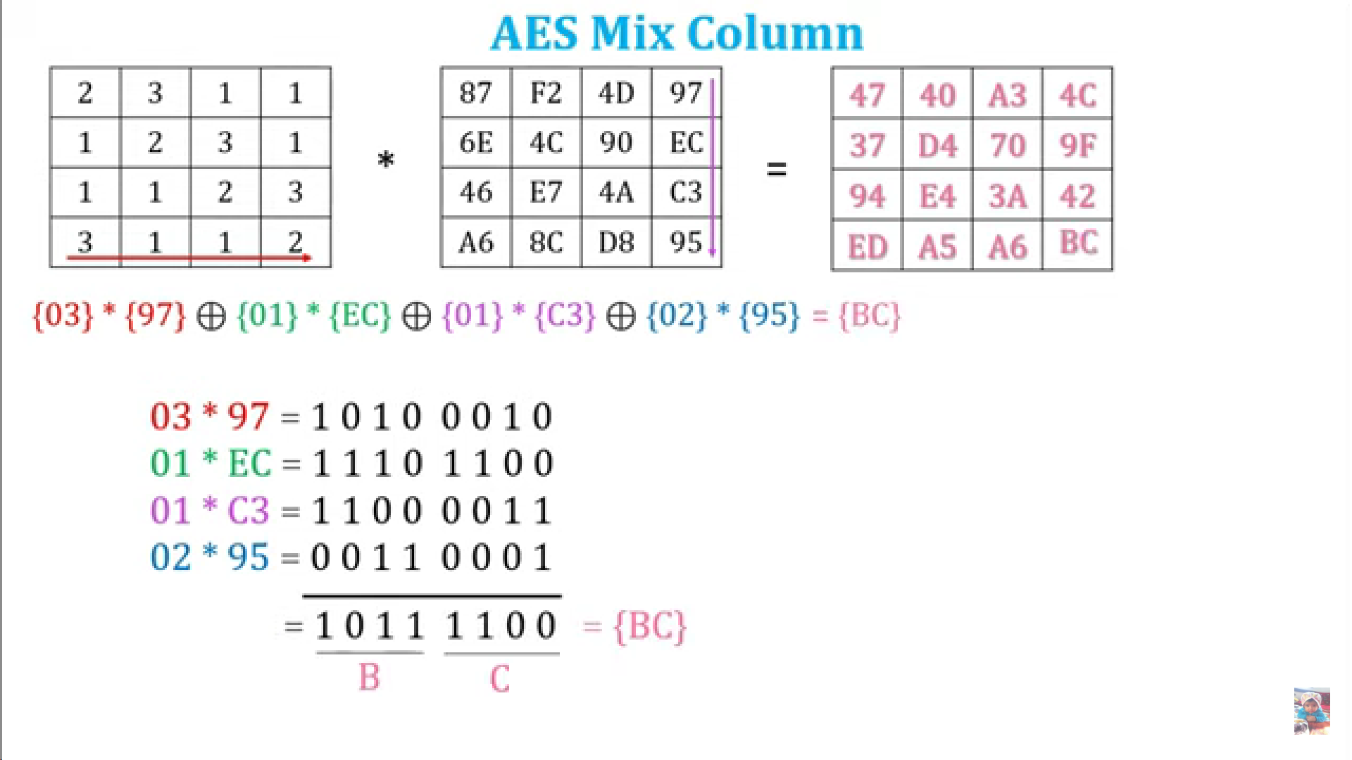

Slide 9
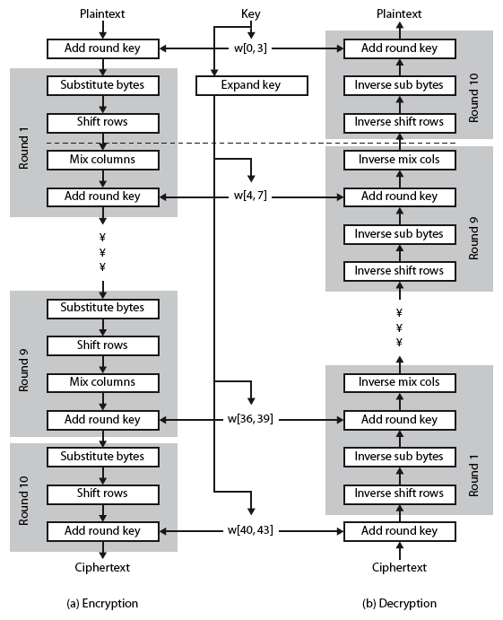
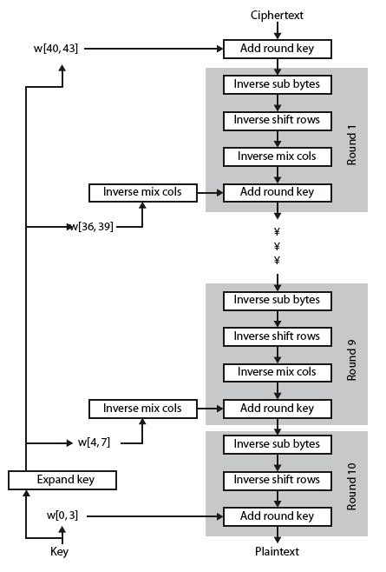
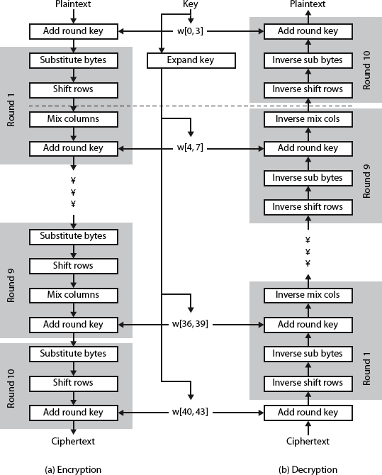
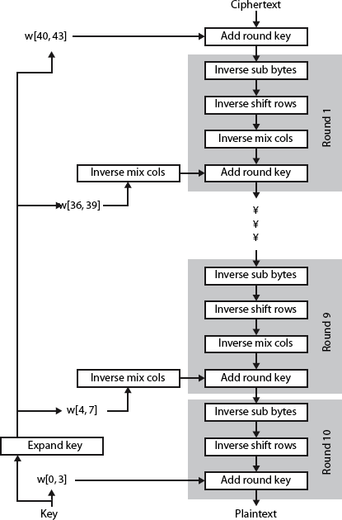
AES Decryption
Decryption

Slide 10
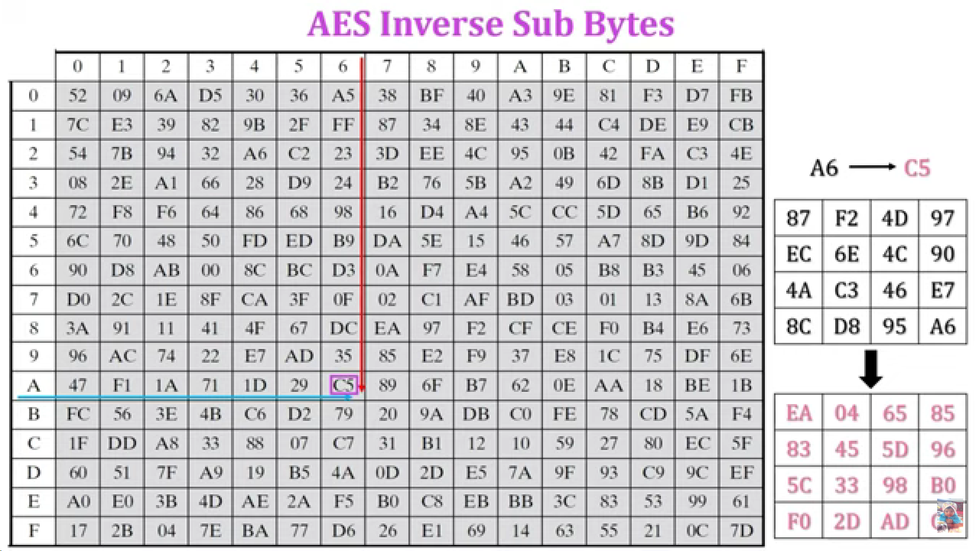
C5

Slide 11
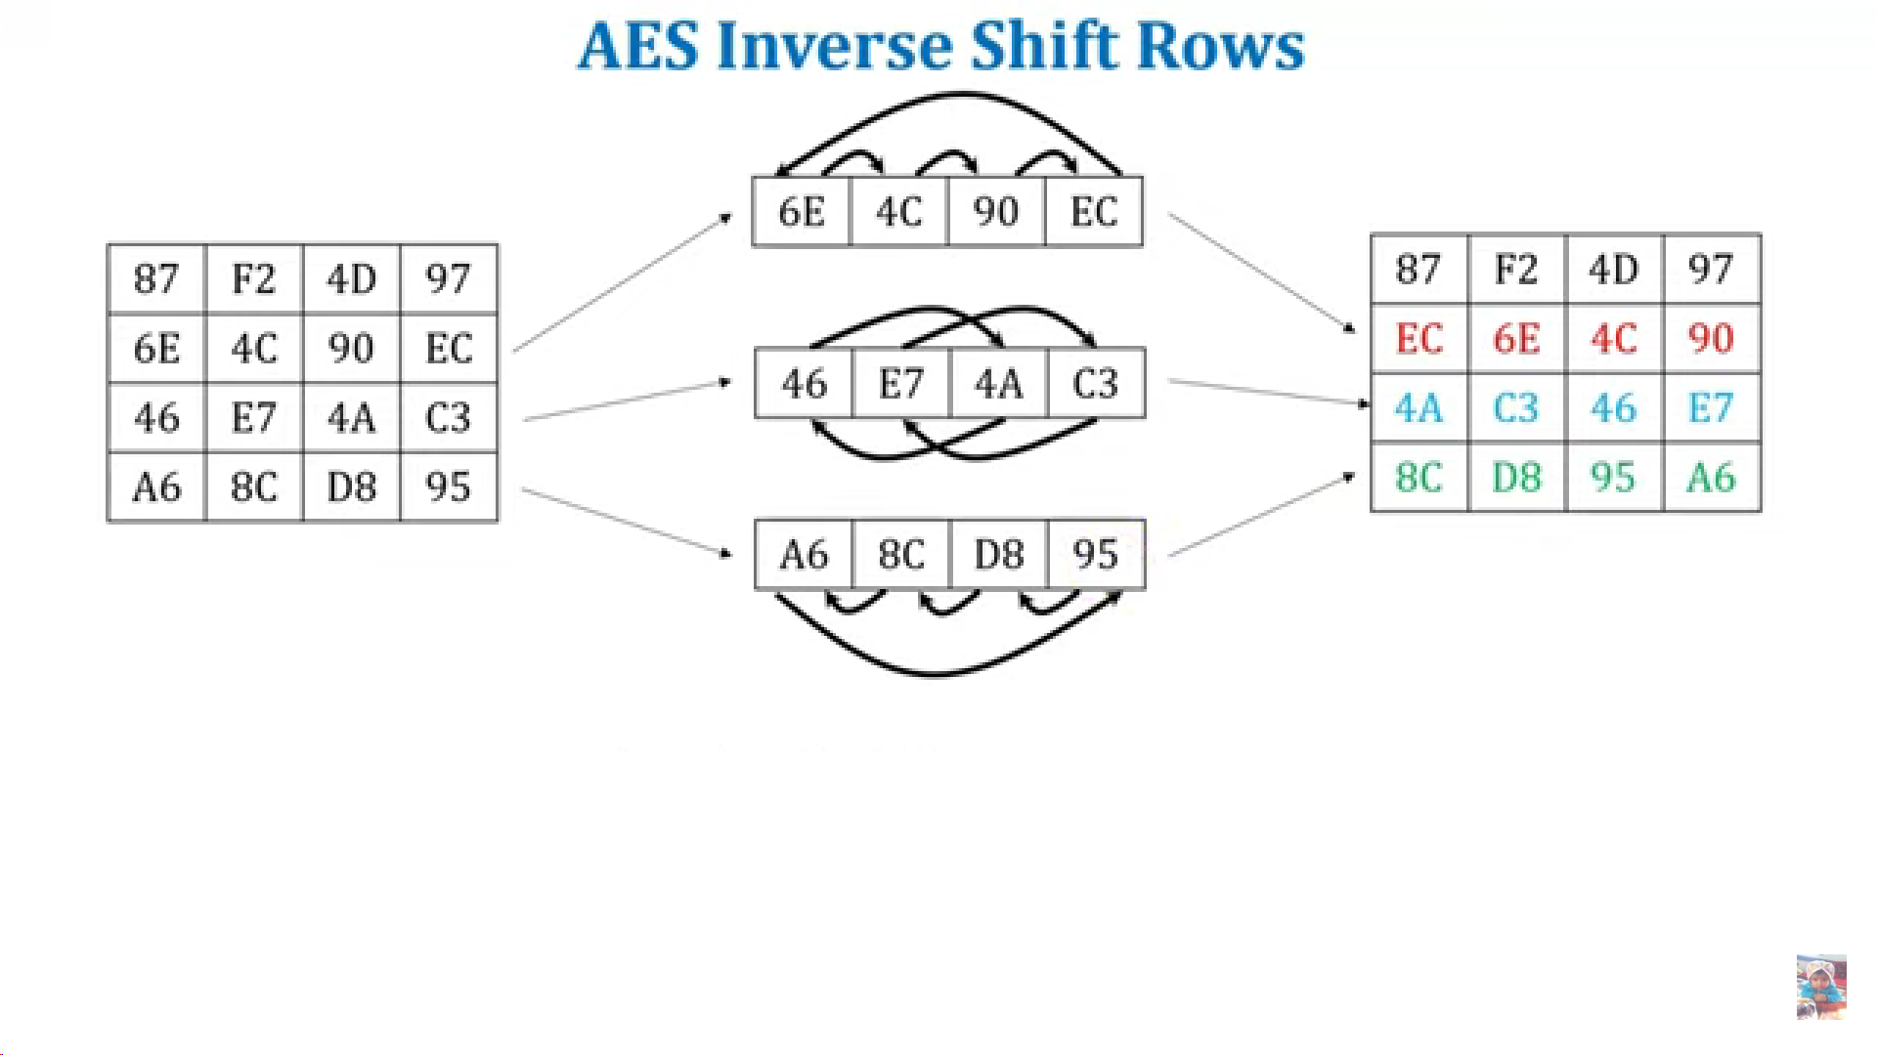
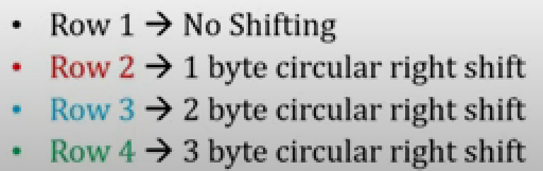

Slide 12
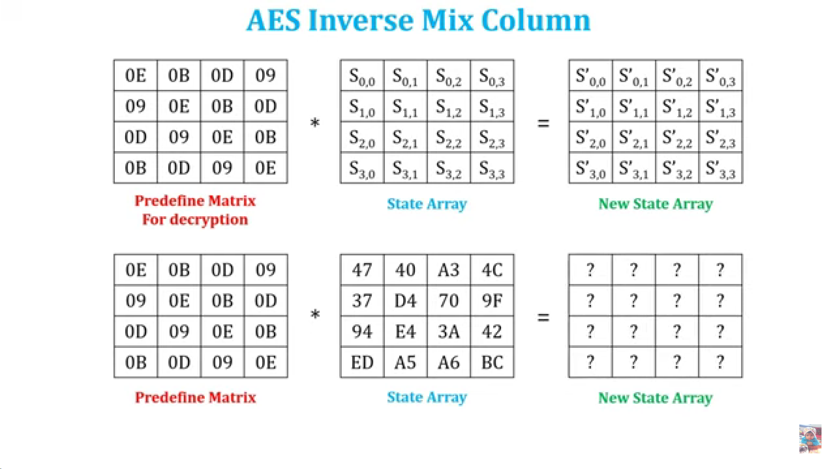

Slide 13
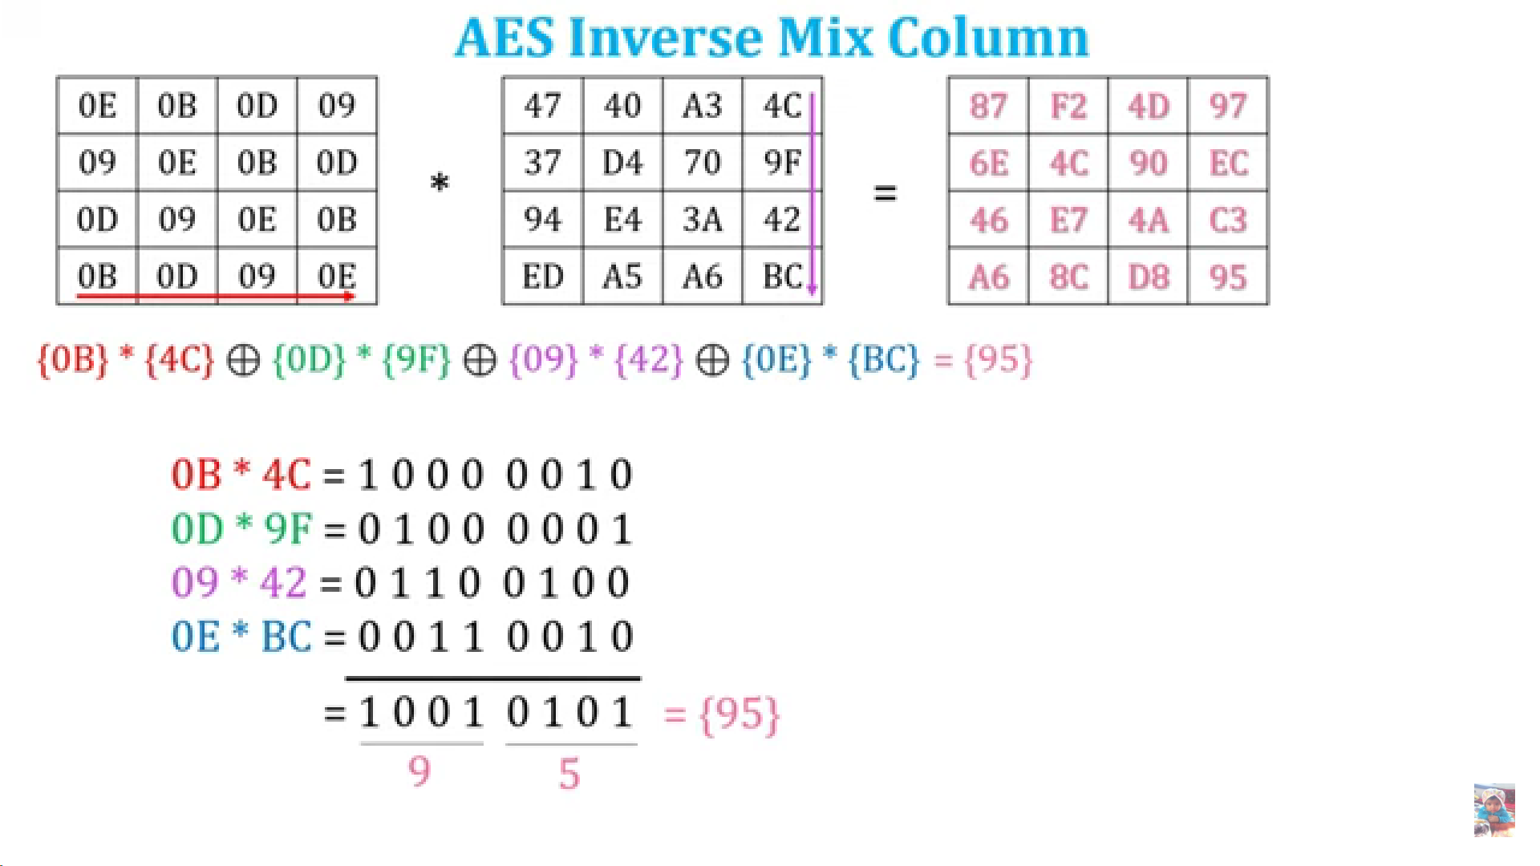

Slide 14
